Slide 1
Model Architectures

Slide 2
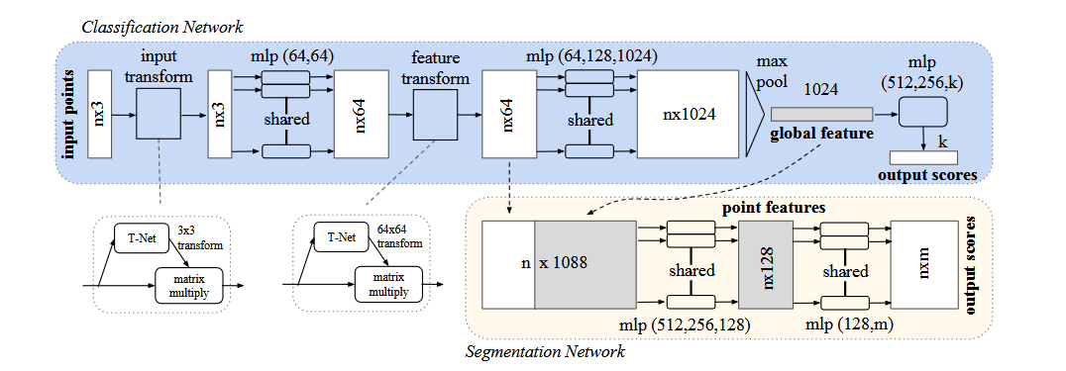
Pointnet Architecture

Slide 3
Pointnet++
Recursively performs Pointnet encoding in a nested partition of the input
Each partition is defined as a neighbourhood containing a centroid location and a scale
Pointnet aggregates points with max pooling -> local features lost
Pointnet++ uses multiple region-based mini pointnets over different abstraction leves
Pointnet++ hierarchical architecture preserves local features better

Slide 4
PointVoxelCNN (PVCNN)

Slide 5
Pointnet VAE
How to train a PointNet VAE
Most important Paper LION

Slide 6
Training VAE
Self-supvervised via Reconstruction loss (standard way)
More advanced techniques CLIP
Train as plain autoencoder -> better reconstruction quality, possibly bad conditioned latent space
Train with small KLD weighting e-6 and slowly increase during training

Slide 7
Goals for next Week
Load meshes and Grasps (Loading of meshes easily done with trimesh)
Transform meshes into pointclouds (also easily done with trimesh)
Preprocess the point cloud and the grasp data (preprocessing code from Ulf)

